Slide 1
Can you Predict the Premier League?
Using ML to get an idea of where your team will finish

Slide 2
PROPOSAL
In essence, our proposal was to see whether we could use ML to create a model that would categorise where a football team would finish in the English Premier League.
Three bins created into which each club would be placed:
European Places (Top 6)
Mid Table Safety
Relegation fight (Bottom 6)
By utilising a range of statistics, the intention is to train a model that would take this information and use it to put each EPL team into one of these three bins. Accuracy would be determined by comparing the bin that the model placed them into against what actual bins they would fall into in real life.

Slide 3
DATA COllection
The use of data in football has exploded in the last few year – from what is collected to how it is used e.g. betting odds, a “moneyball” approach for player valuation etc.
Success would therefore be determined by choosing the right statistics to use and place in a csv.
We decided to collect data over the last 5 EPL seasons.
The original data that was collected consisted of:
Season | Team Name | Squad Value
Wage Bill | Retained Manager ? | Average Home Attendance
Transfer Spend | Retained Captain ? | Manager Salary
Net Number of Transfers | Previous Season Goal Difference | Previous Season Position
Previous Season Disciplinary Points | Position Bin

Slide 4
INITIAL DATA CLEANUP
Manager salary was discarded – there was insufficient data to gain anywhere near a complete dataset.
There was the issue of dealing with sides that were promoted from the Championship to the Premiership the previous year.
In terms of previous season’s position, the side that was in first place in the Championship was given a position of 18th, second 19th and third (or lower via the play-offs) 20th.

Slide 5
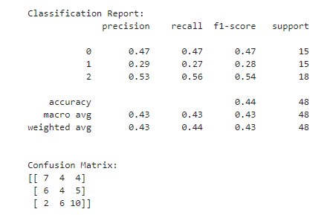
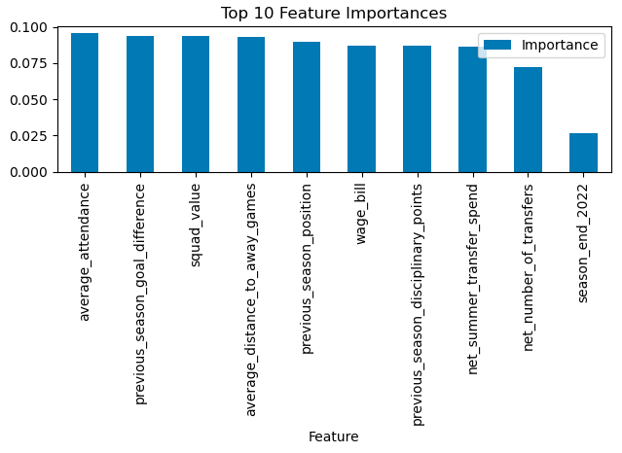
ORIGINAL MODEL
The data was uploaded and a Random Forest Model, and gave the following results:

Slide 6
Optimising our model
Once we looked through the model, it was obvious that there were some datapoints that we were not happy with, and seemed inconsistent with what we were trying to achieve. Previous Season’s Goal Difference – promoted teams in their promotion year had a much higher goal difference than would be expected. This was changed to the goal difference they had during the last season that they were in the EPL when they were relegated.
Season and Team Name were dropped – they are useful markers, but they do not affect performance.
Average Distance to Away Games was dropped – whilst local derbies effects are well known, it seemed irrelevant as it emphasises geographical location as opposed to more footballing reasons.
The number of Games Played and the number of Managers employed by each club for each season were also added to give more features. One concern last season for example for the mighty AVFC was that their EPL form would suffer due to playing more matches in Europe. Also a stable management team is usually the sign of a successful, well run club.

Slide 7
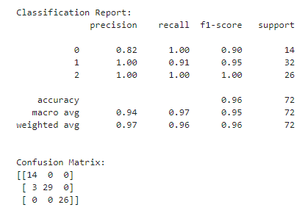
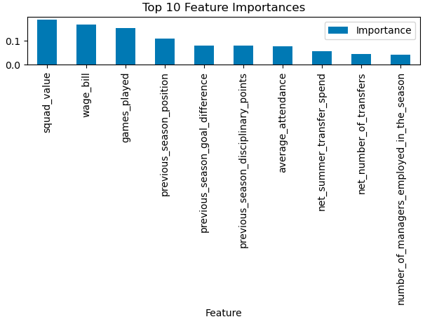
REFINED MODEL 1
The data was uploaded and a Random Forest Model, and gave the following results:

Slide 8
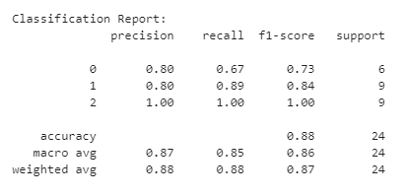
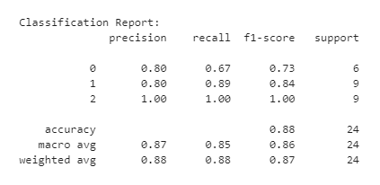
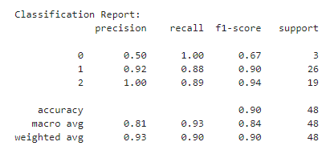
REFINED MODEL 2 – Bottom 5,4,3.
The data was uploaded and a Random Forest Model, and gave the following results:
Bottom 5 Bottom 4 Bottom 3

Slide 9
FURTHER OPTIMISATIONS
Refining the Random Forest Model – hyperparameter tuning and feature selection were applied.
Using different ML models – a Neural Network, a Support Vector Machine and Gradient boosting.
None of the above increased the accuracy to above what we already had, suggesting we had a fairly optimal solution to start.
In short………we got lucky!

Slide 10
REFINED MODEL 1
The data was uploaded and a Random Forest Model, and gave the following results:

Slide 11
DEMONSTRATION

Slide 12
Interactive Predictor app
Building a predictor app makes our model useable and interactive
It might just be a bit of fun for fans, but could it also become a business tool for the premier league?
Can it be applied elsewhere? - other leagues at home or overseas?
Can it be applied to other sports?
What other features might we be able to add? – more variable options?

Slide 13

Can you Predict the epl?

